Slide 1

Computational Social Science Analytics Project
(An Insight from Hong Kong Protests)
Brought to you by Team The Supreme Press
Bu Wende, Jiang Hanyu, Qi Haodi & Zhang Chengzi
Notes:
Welcome, to the supreme leader’s panel discussion!
Hong Kong is seeing its most dramatic time in this century as protestors took to the street since early June this year, against the government from passing the Extradition Law Amendment Bill. People have been expressing all kinds of comments on social media platforms such as Twitter and Reddit. Researchers and news media agencies are keen to find out how people interact with one another online and what is the general public sentiment towards this issue. They will definitely be interested in a more scientific and systematic approach to analyse this social media landscape.
Today we have on board computational social scientists Haodi Qi and Reddit Analyst Chelsea Zhang to talk more about the work they have done so far!
Wende: Mr Qi, your team has collected 100 thousands data, how did you process it?
Haodi: network analysis: combine two data sets, remove duplicates, split according to dates.
Wende: Can you share more about your findings with the audience?
Haodi: network:
- always a few prominent individuals in the network whose tweets have major influence to the public, regardless of the network size.
- These influencers generally serve their own communities. For example, Twitter user @Woppa1Woppa has consistent high centralities. He is a Hong Konger-both-Canadian covering the Hong Kong protests issue in English, he serves as an “insider” for the Hong Kong issues to the English-speaking western world.
- However, some of these influencers do not stay the same, as we can see that some prominent nodes in one of the network graphs may disappear in the next day’s graph. This could be attributed to the suspension of the account, or simply because they never post any tweets the next day.

Slide 2
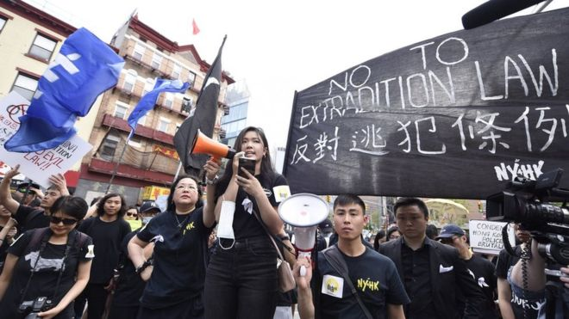
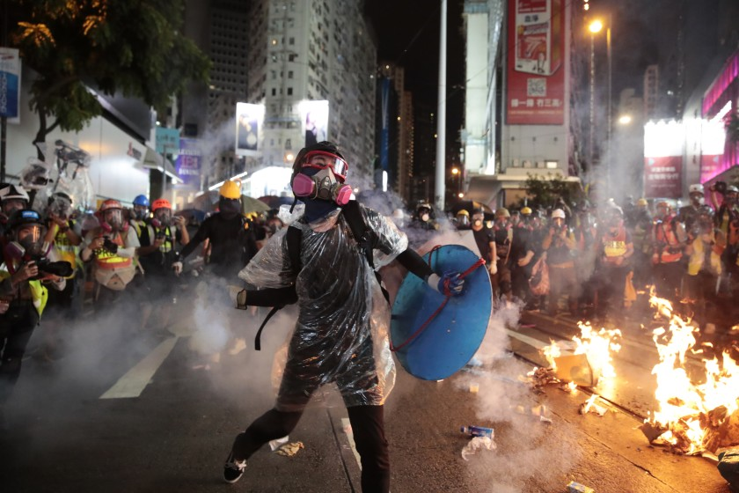
Anti-Extradition Law Amendment Bill Movement in Hong Kong

Slide 3

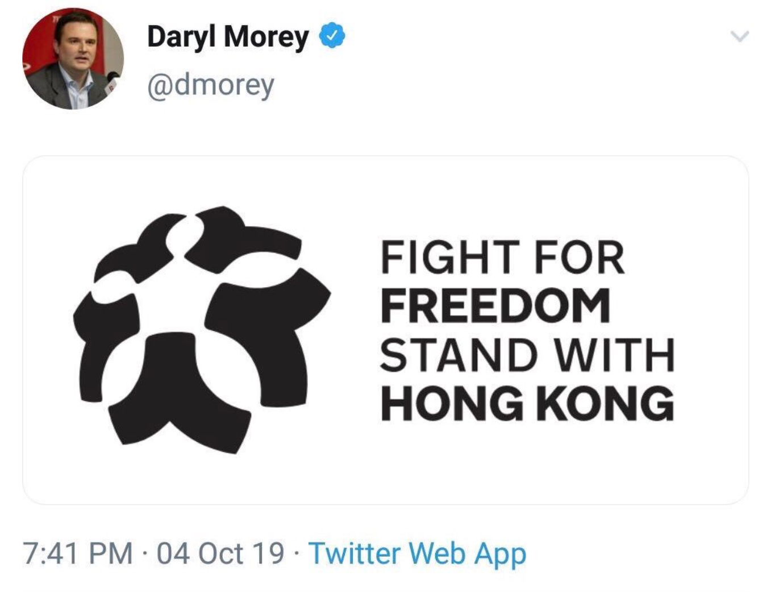
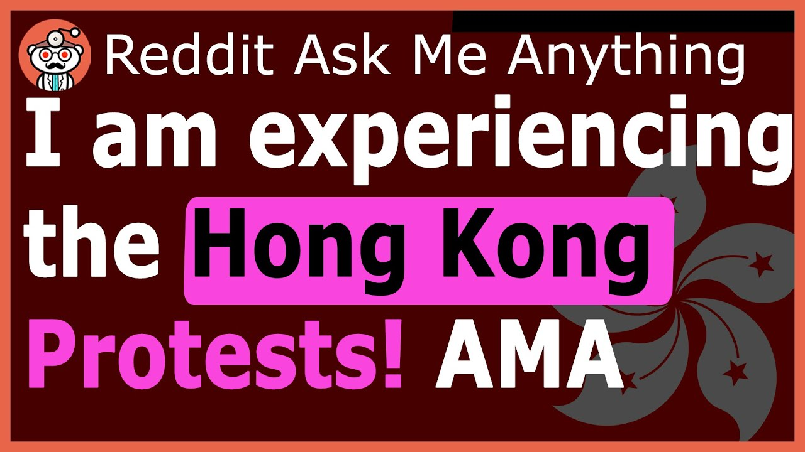

Expressing views on Social Media Platform

Slide 4
TWITTER
TEXT ANALYSIS
01
TWITTER
NETWORK ANALYSIS
02
TABLE OF CONTENTS
REDDIT ANALYSIS
03
CONCLUSION & FUTURE DIRECTION
04
By Computational Social Scientist Haodi Qi
By Social Network Researcher Hanyu Jiang
By Reddit Analyst Chelsea Zhang
Vision for the Group and Concluding the panel discussion

Slide 5
Supreme Leader’s Panel Discussion
LIVE
Moderator: Wende BU
Haodi QI
Computational Social Scientist
Hanyu JIANG
Social Network Researcher
Chelsea ZHANG
Reddit Analyst

Slide 6
01
Twitter Text Analysis

Slide 7


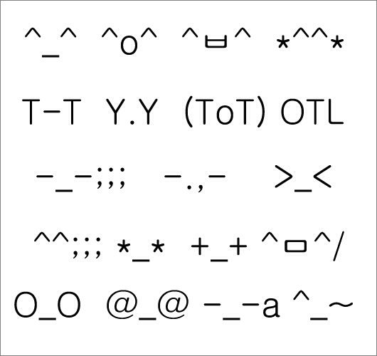

How to deal with them

Slide 8
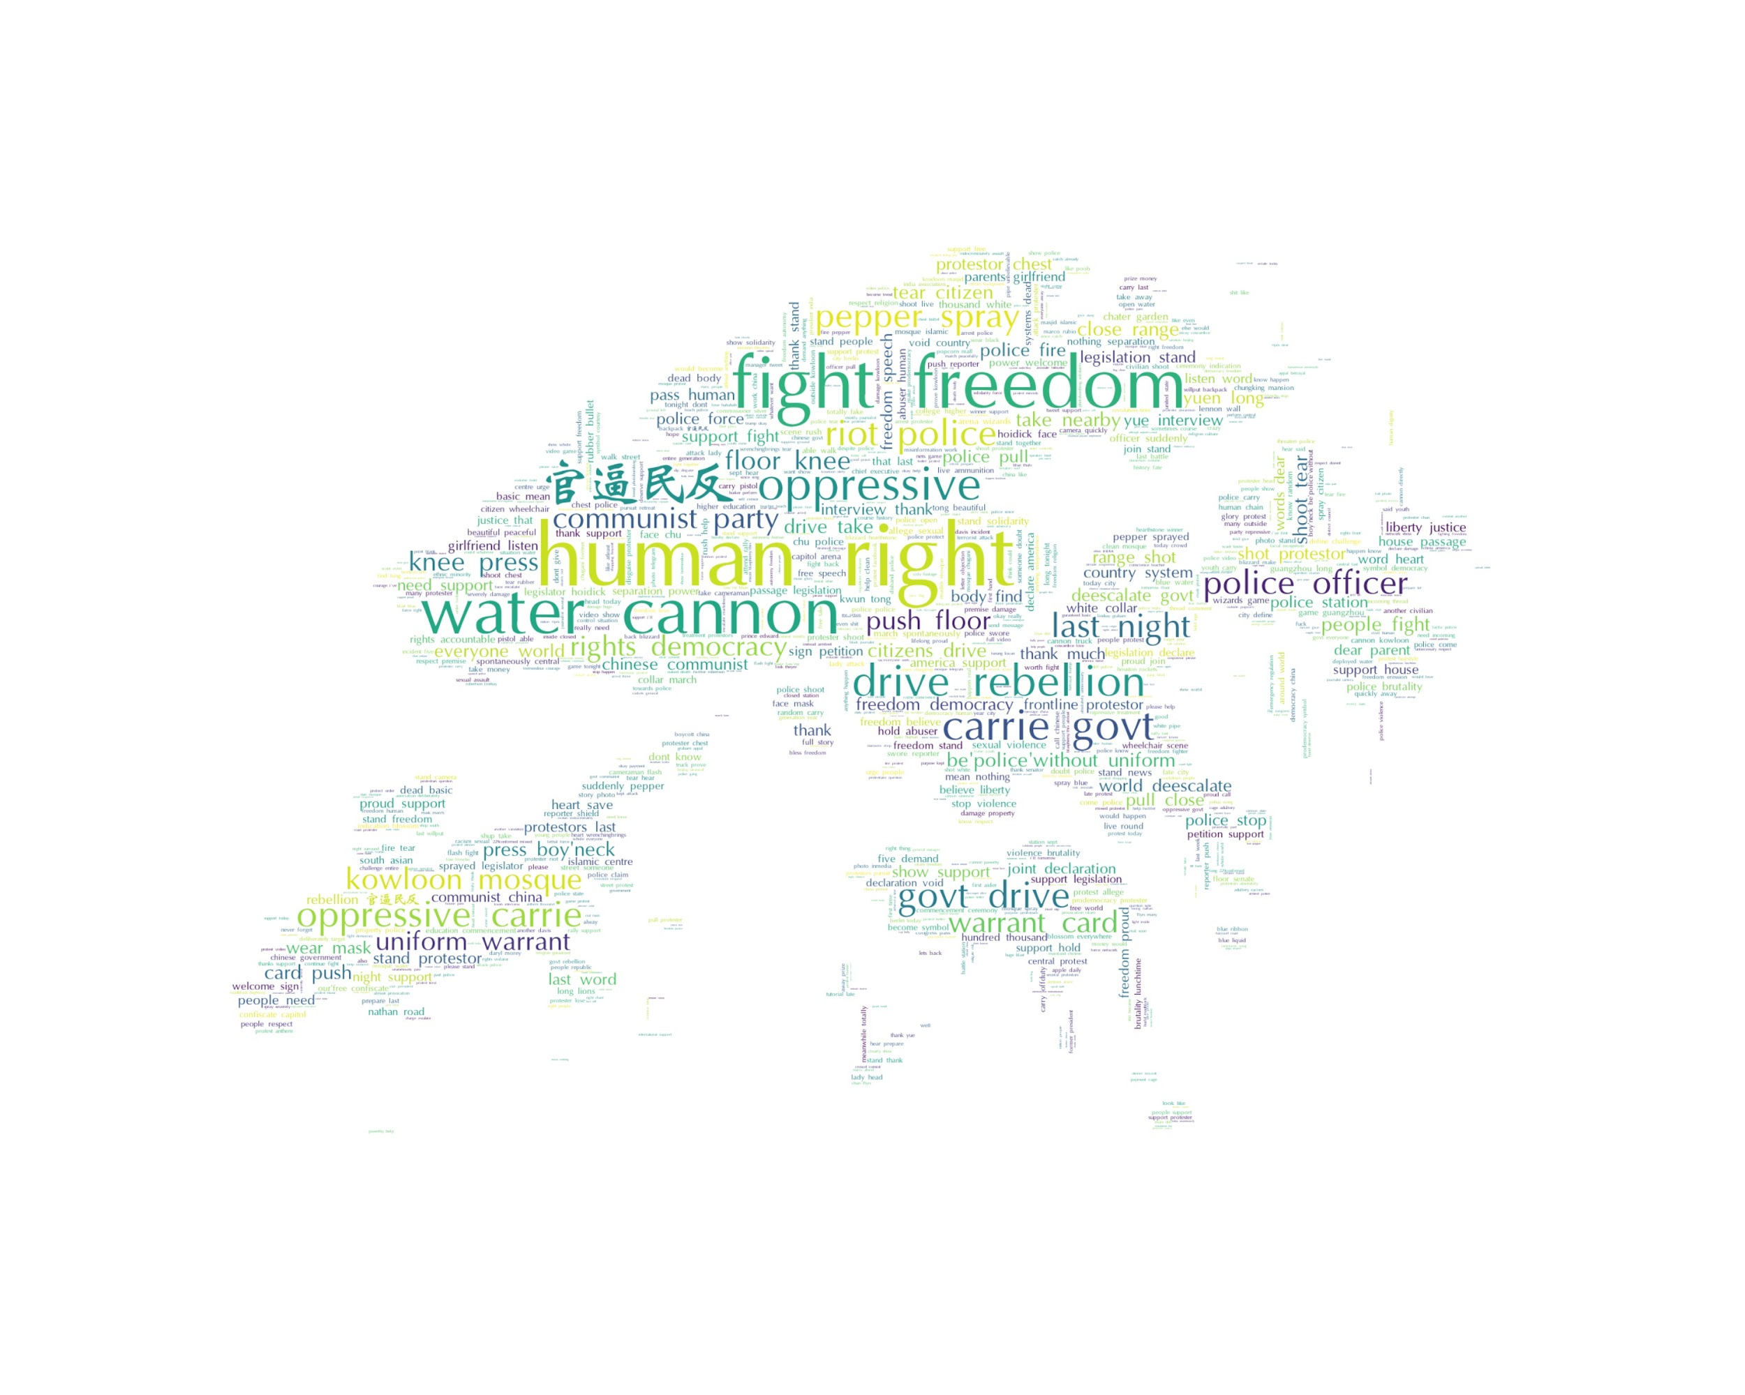
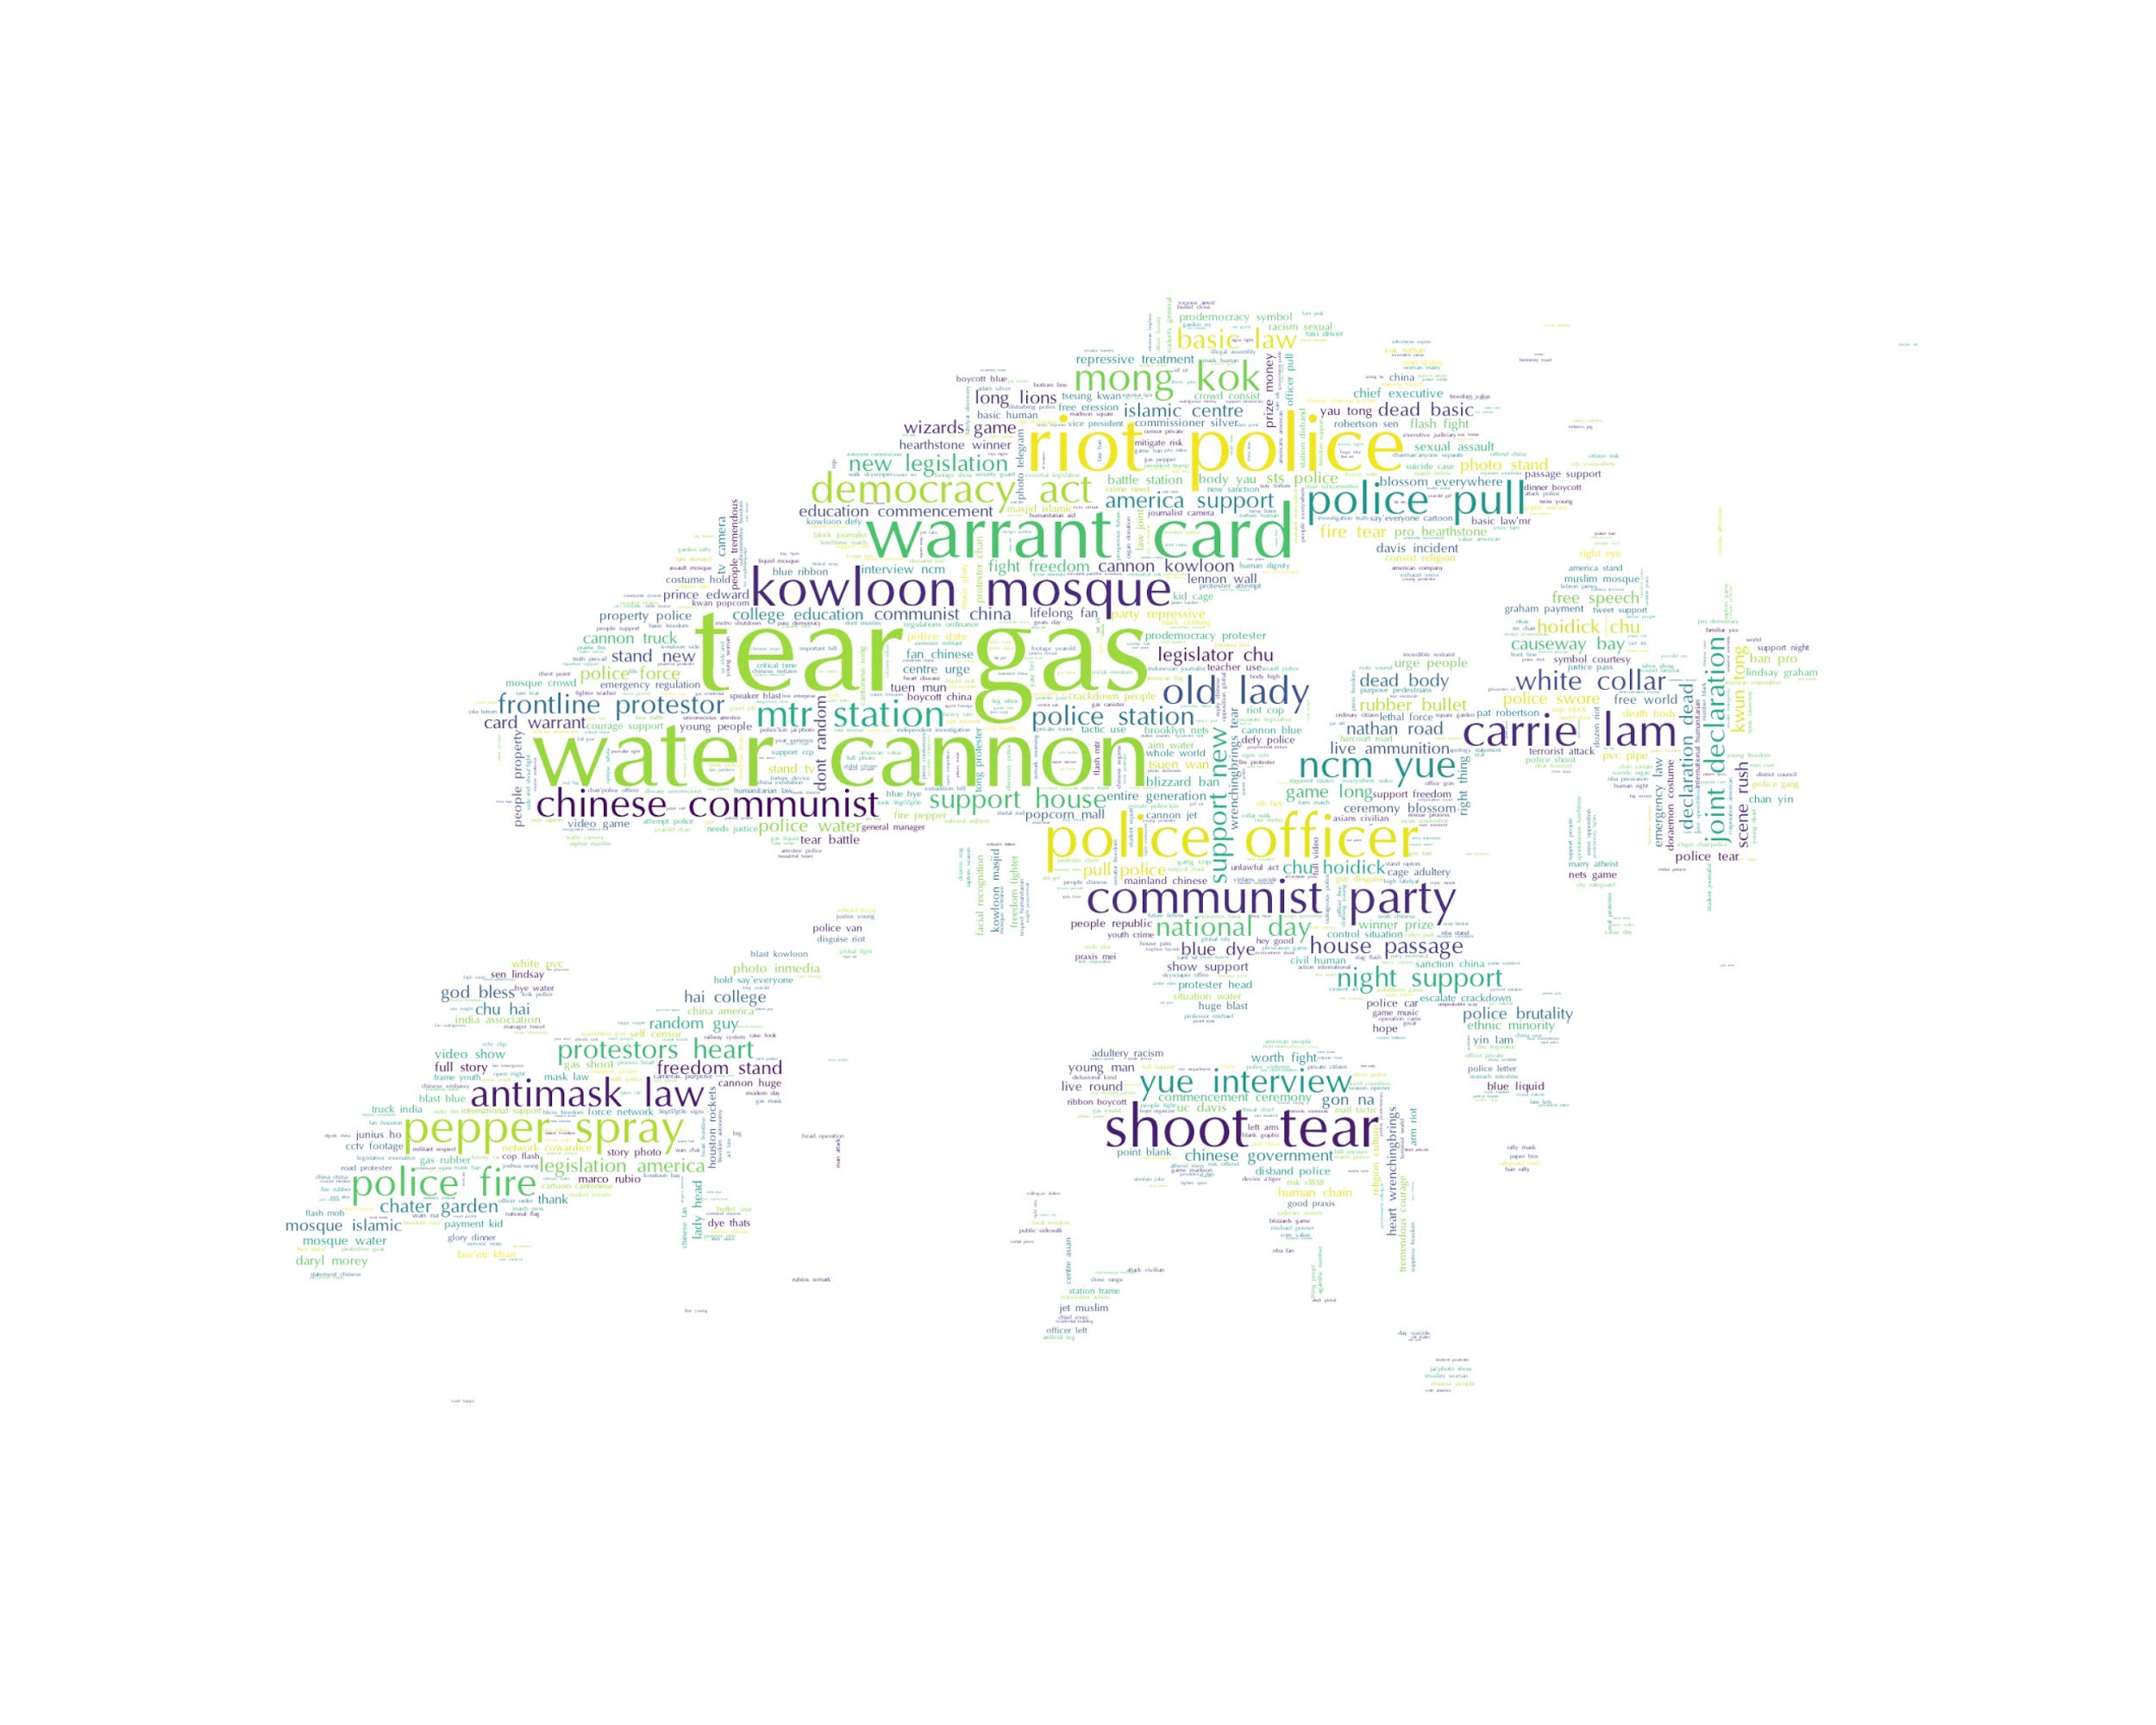
Popular Topic Extraction

Slide 9
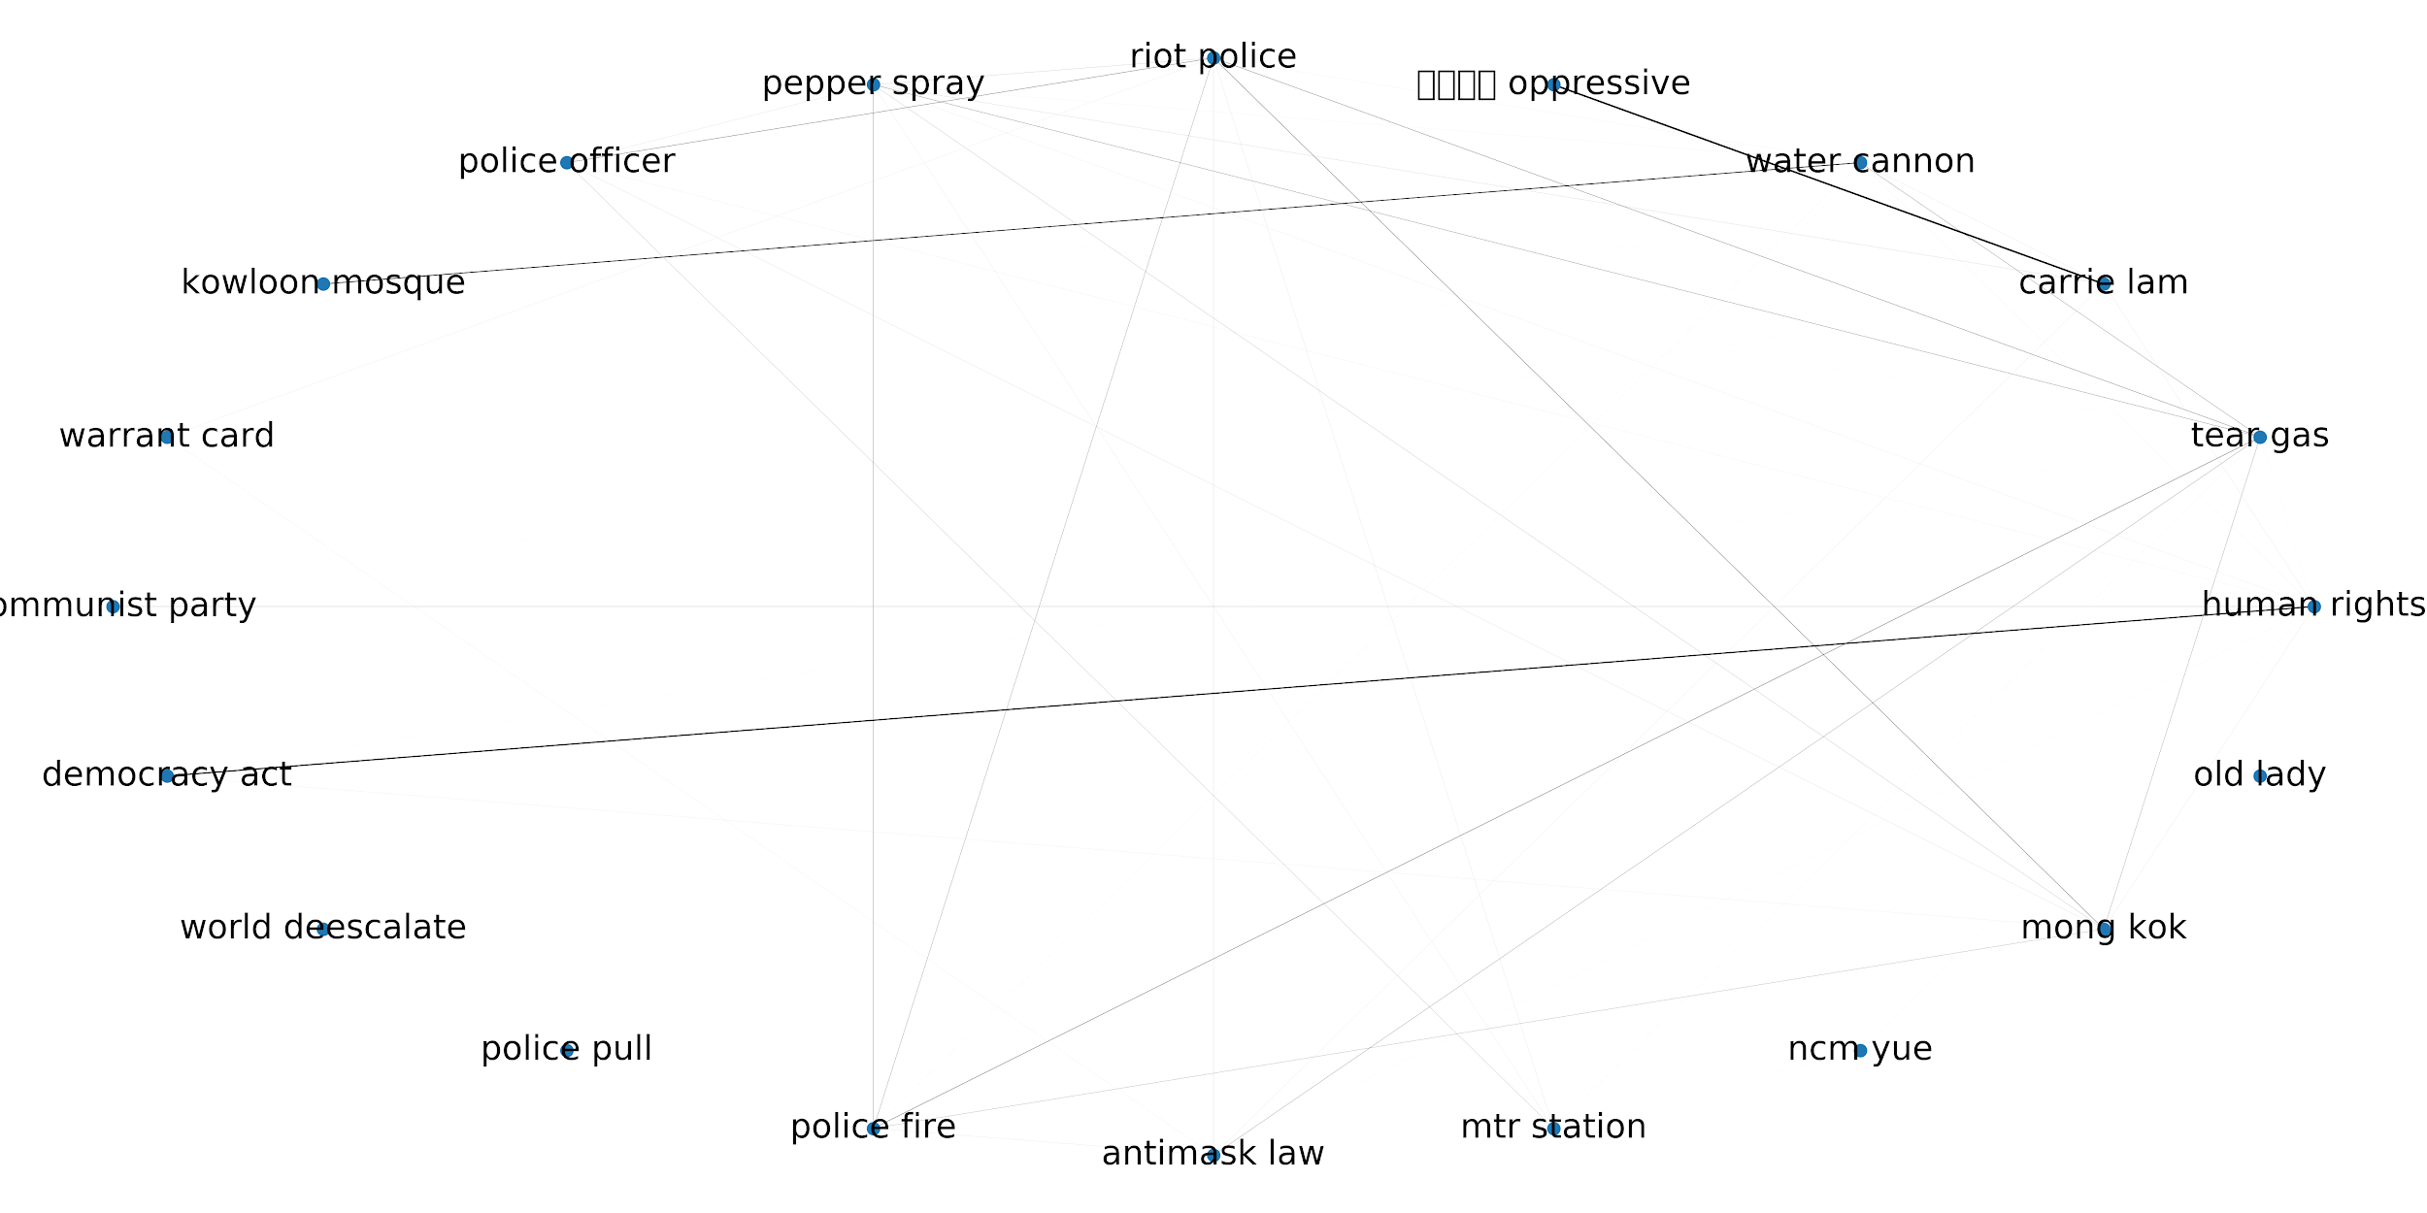
Topic Association

Slide 10
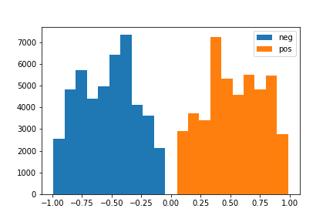
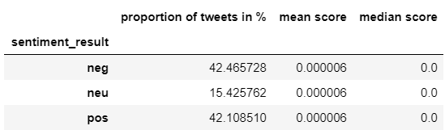
Sentiment Analysis
Aggregation Methods:
Mean Compound Score
Median Compound Score
Sentiment with the Highest Proportion of tweets

Slide 11
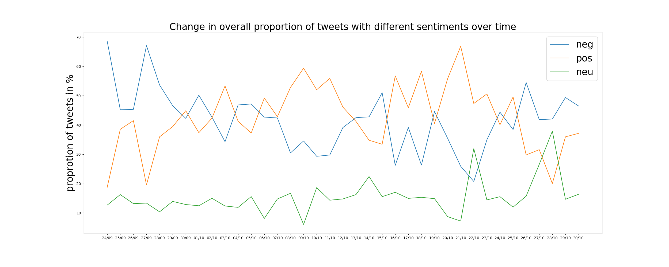
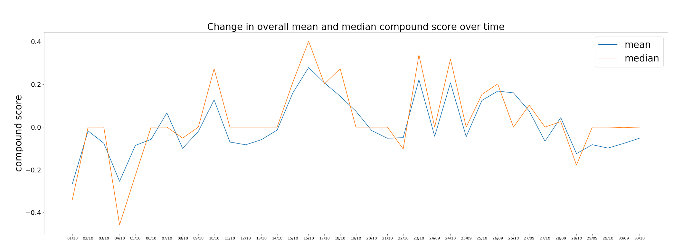
Sentiment Analysis over Time

Slide 12
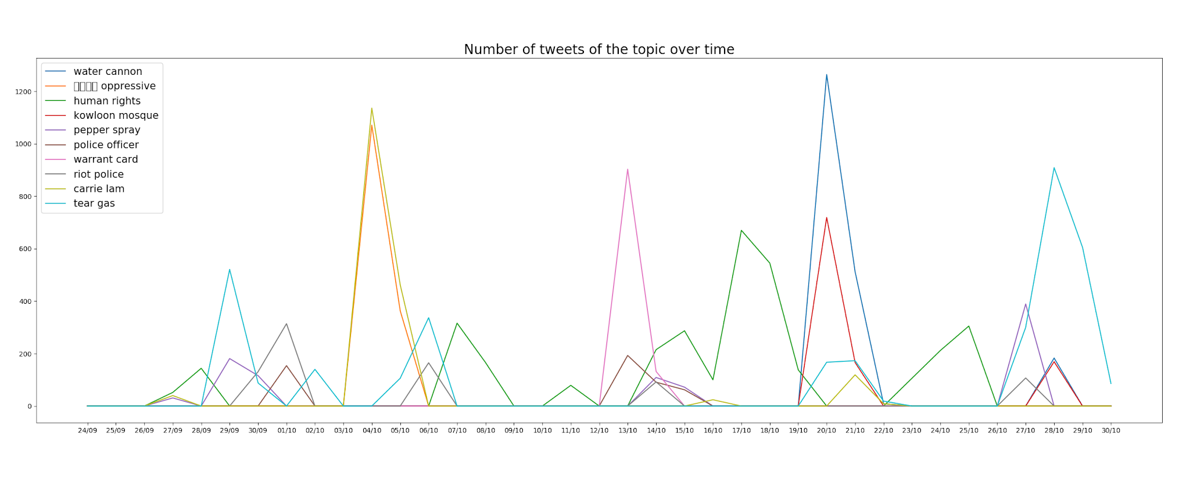
Sentiment Analysis of Topics over Time

Slide 13
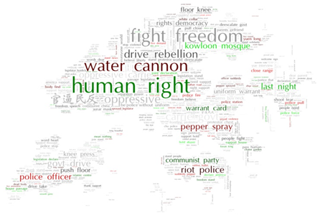
Sentiment Analysis with Word Cloud

Slide 14
02
Twitter Network Analysis

Slide 15
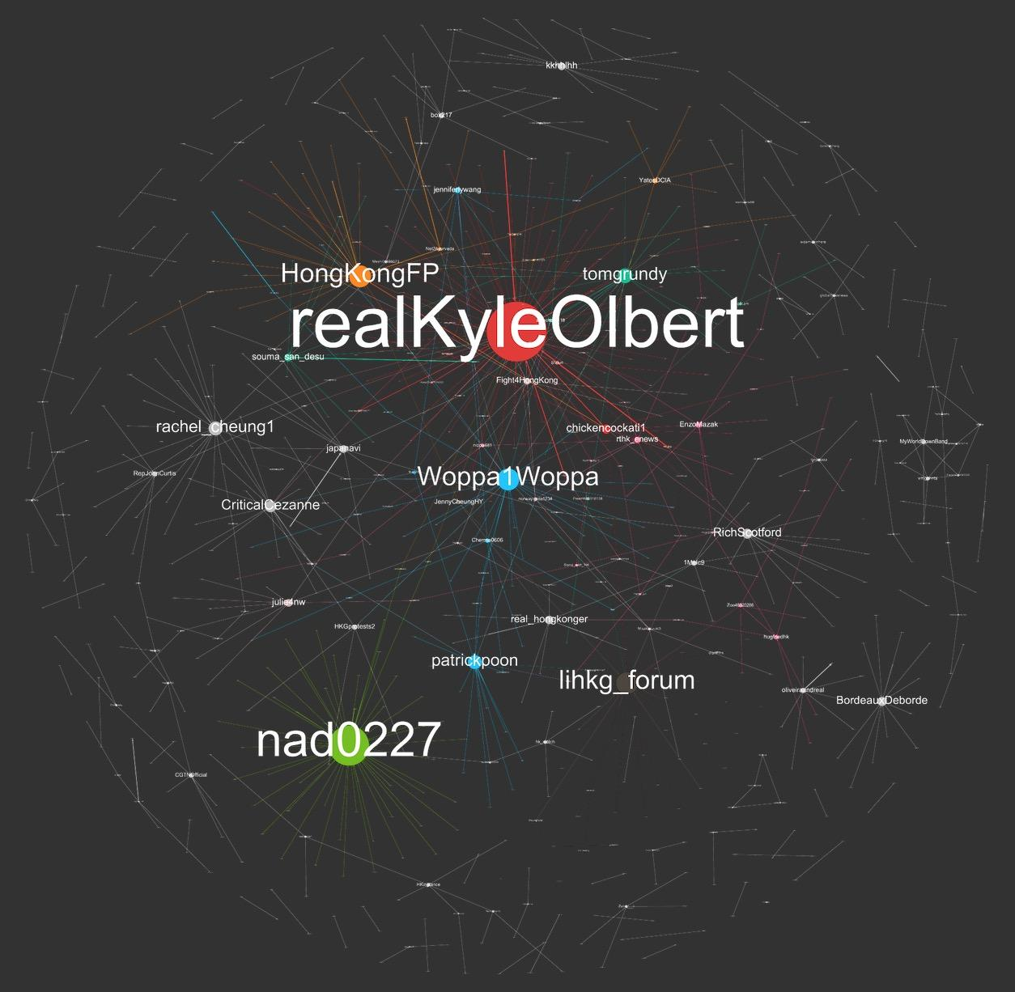
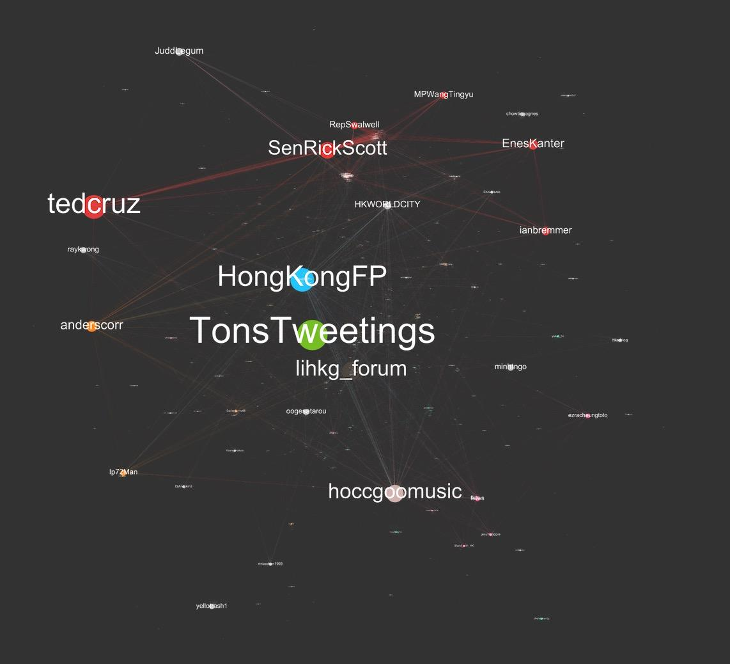
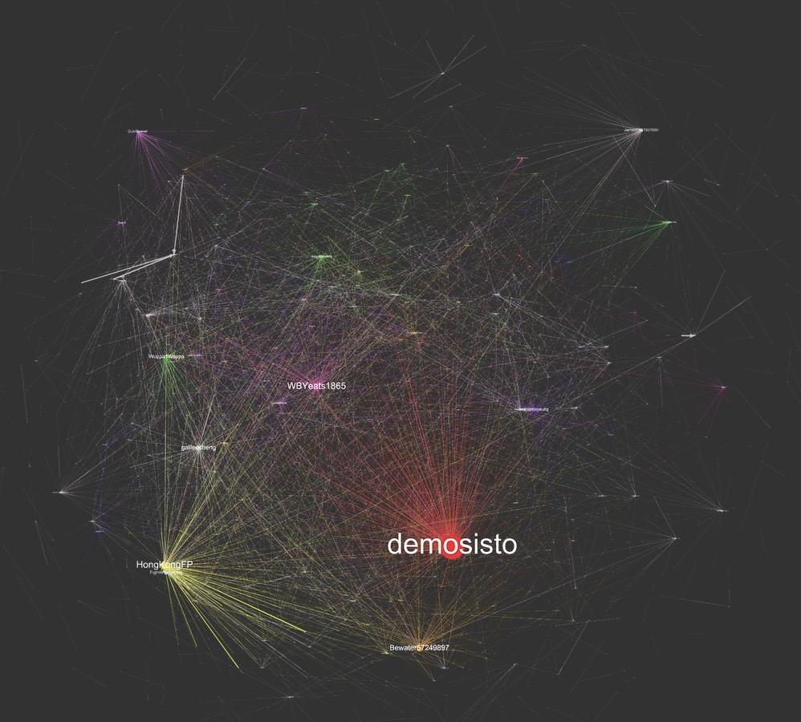

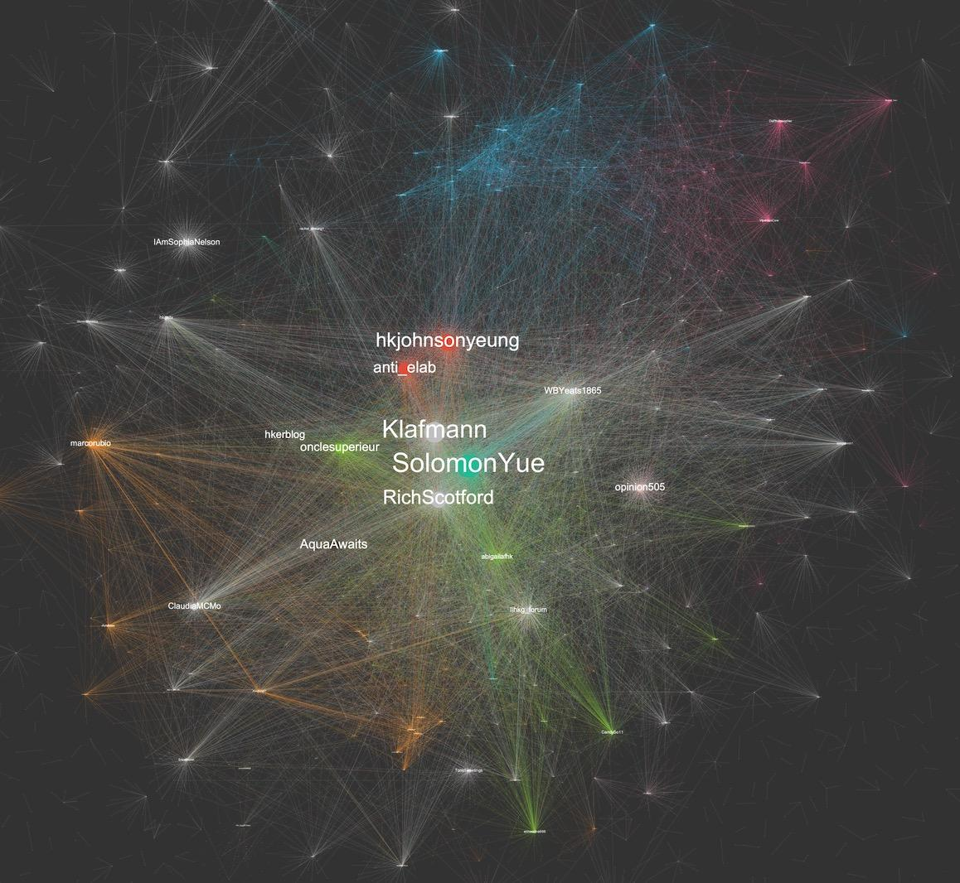
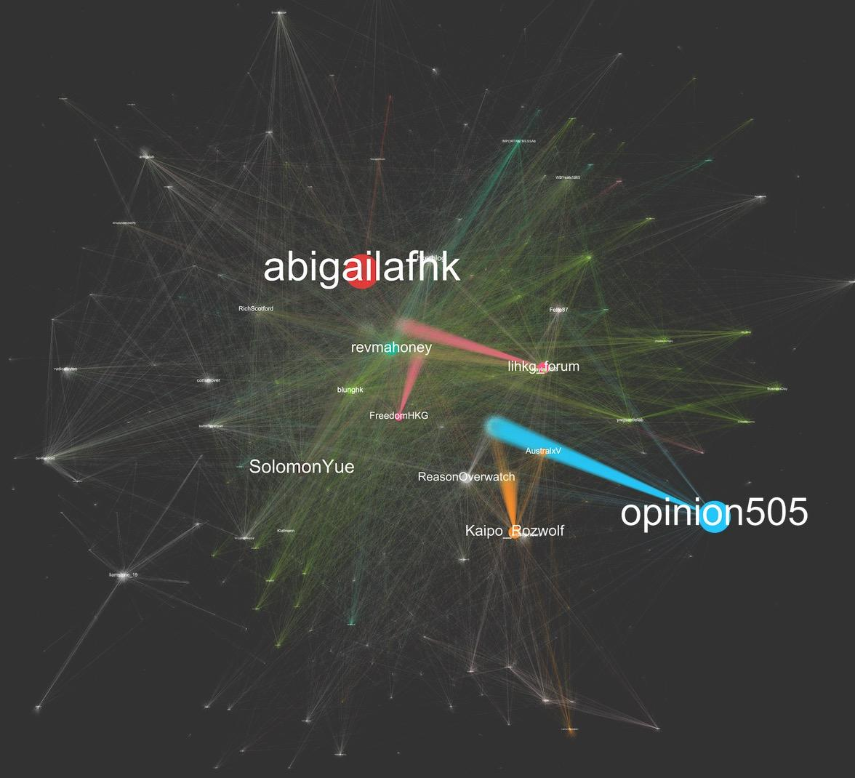
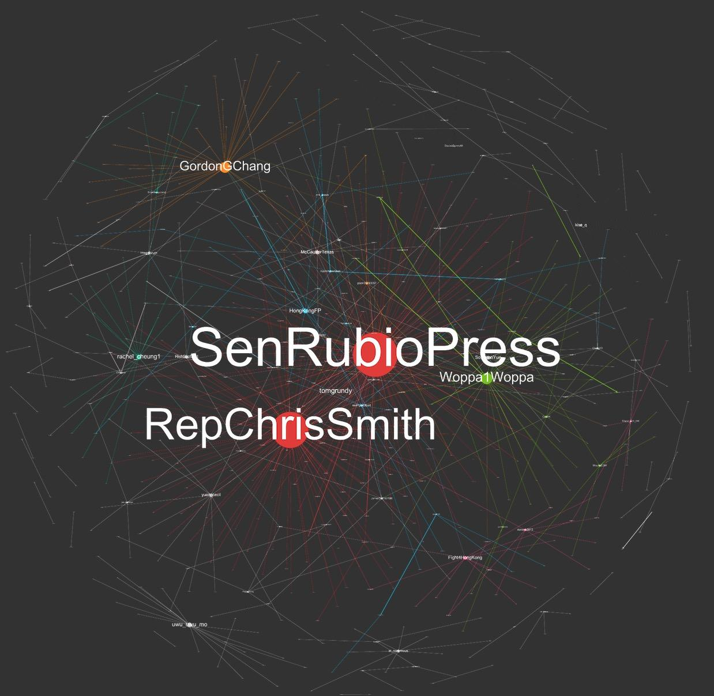
Network Analysis Using Gephi
34
graphs
24 Sep
30 Oct
Find more graphs at: https://thesupremepresses.wordpress.com/

Slide 16
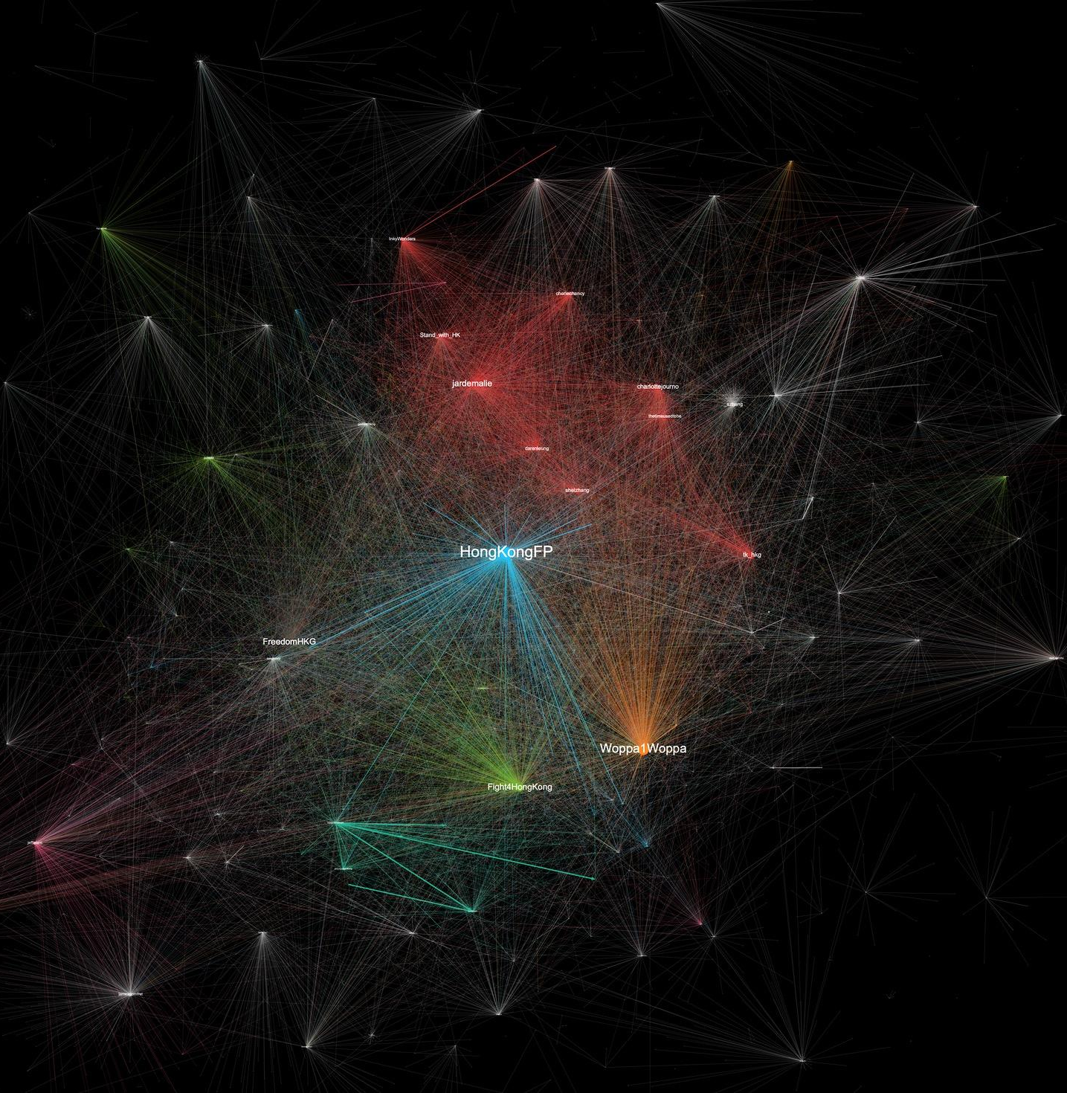
30 Sep 2019
One day prior to Chinese National Day

Slide 17
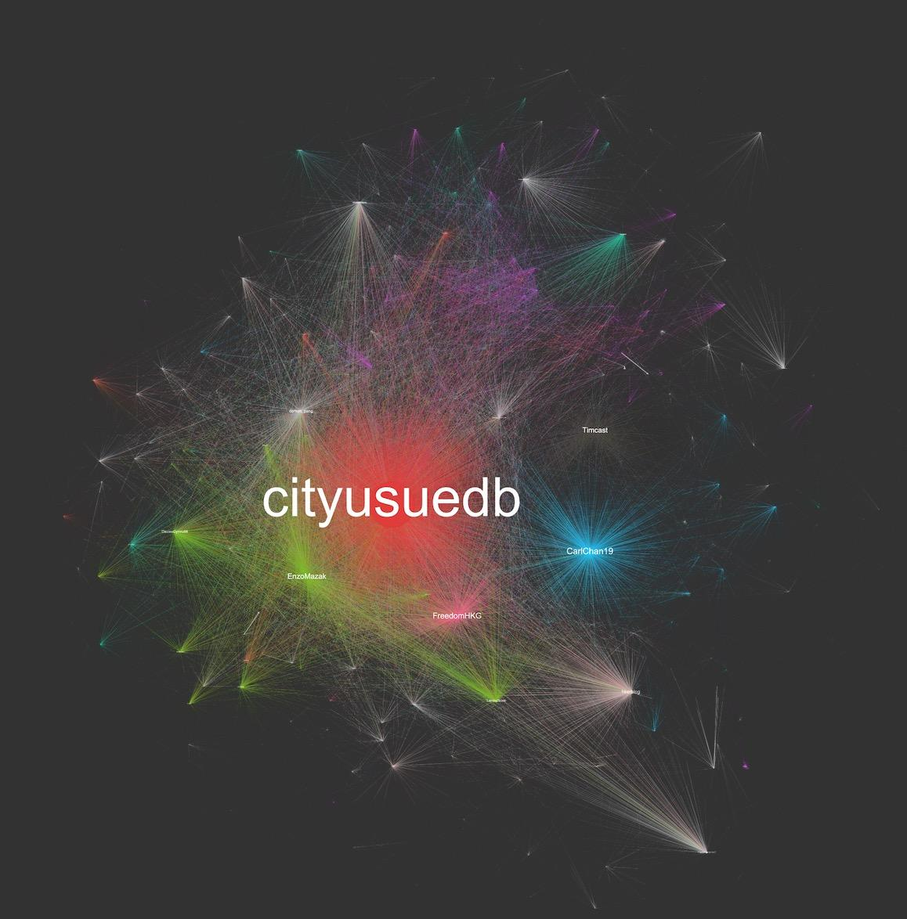
1 Oct 2019
PRC National Day

Slide 18
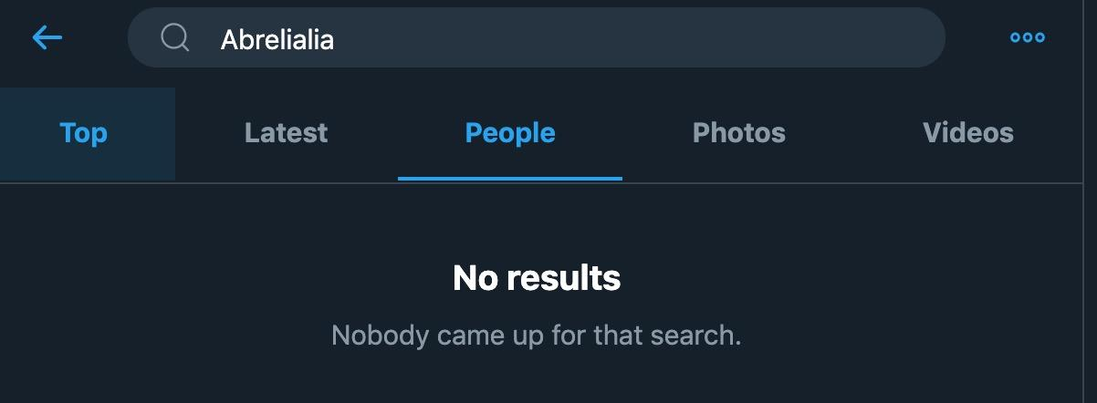
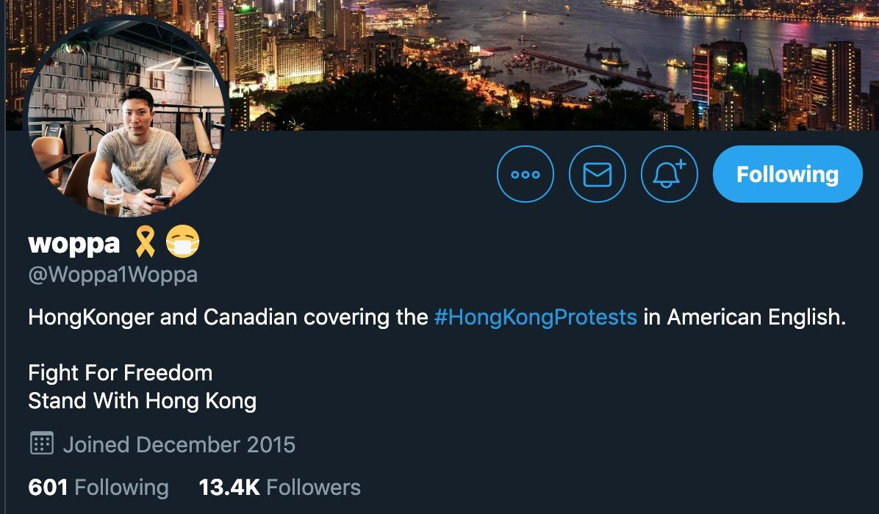
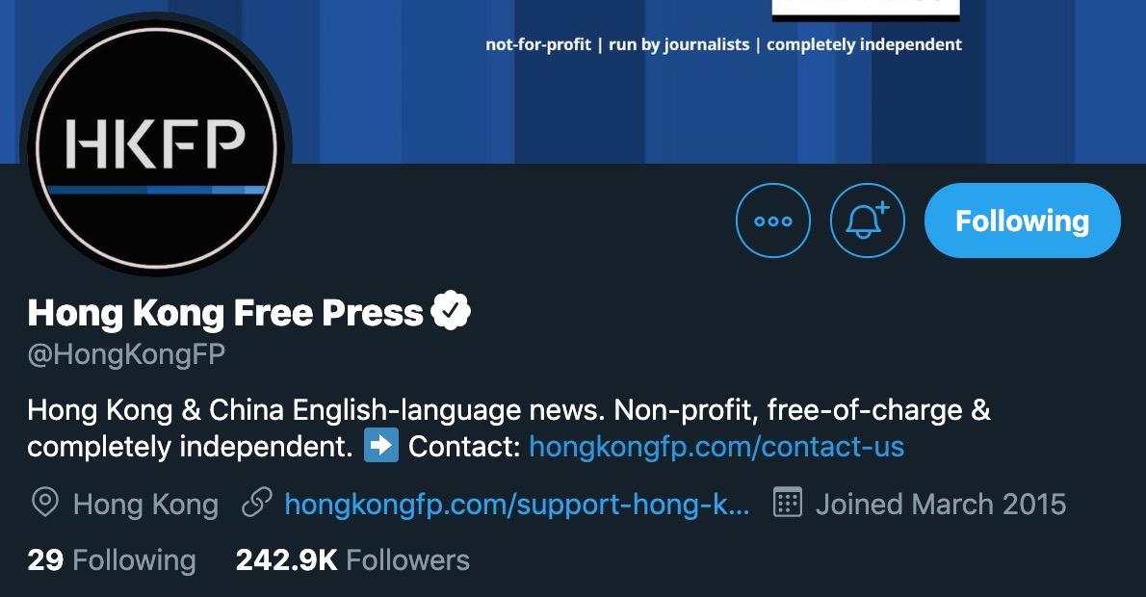
Twitter Influencers

Slide 19
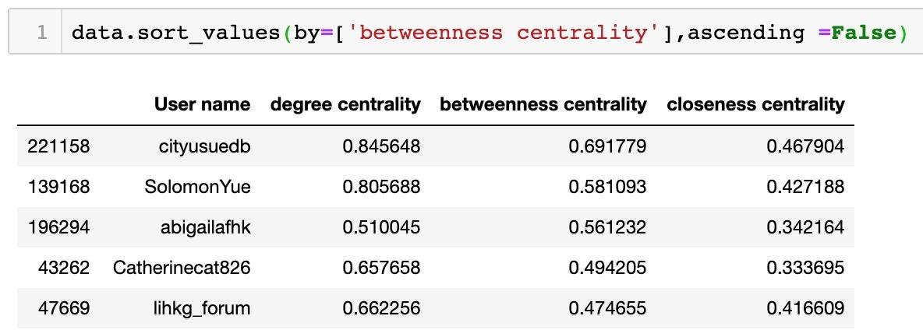
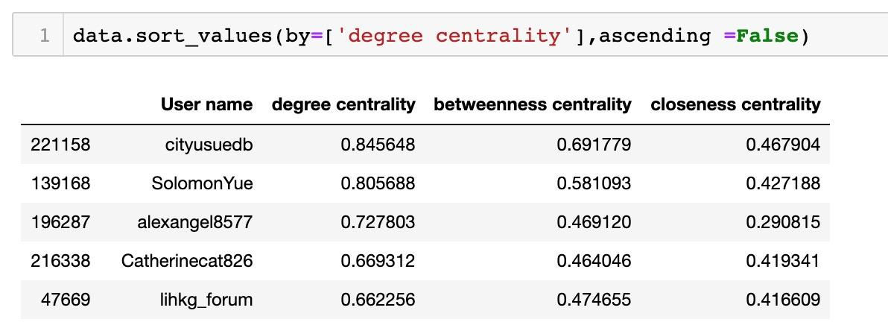
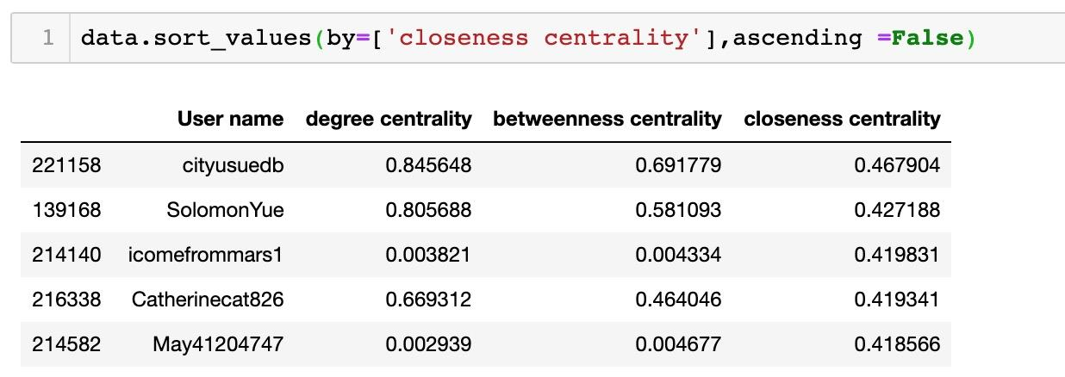
Network Analysis Using Python
Networkx to calculate the centralities
Pandas to process 360 thousand row of data

Slide 20
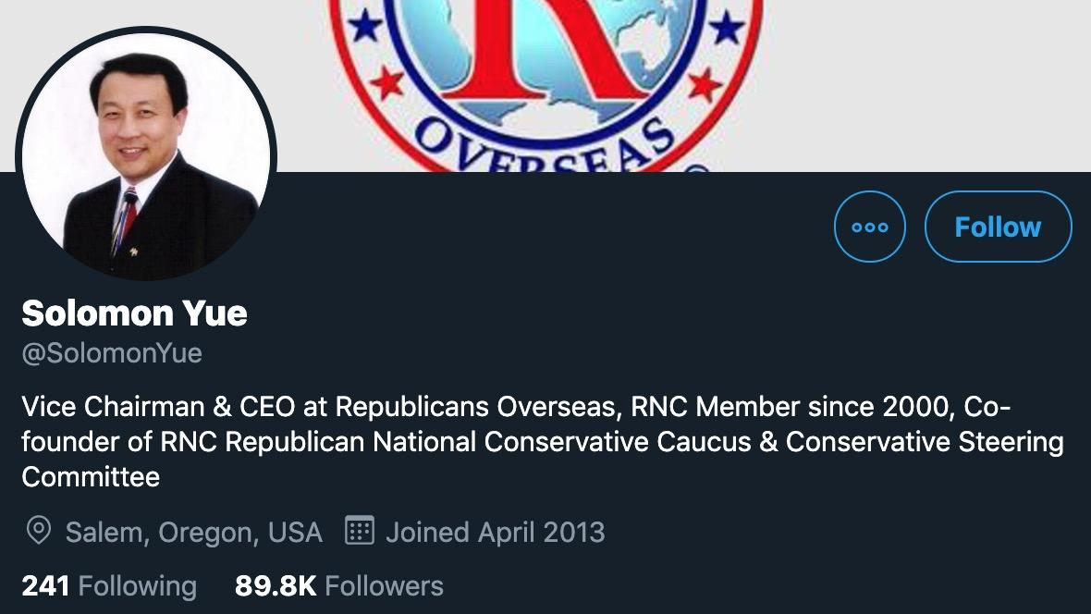
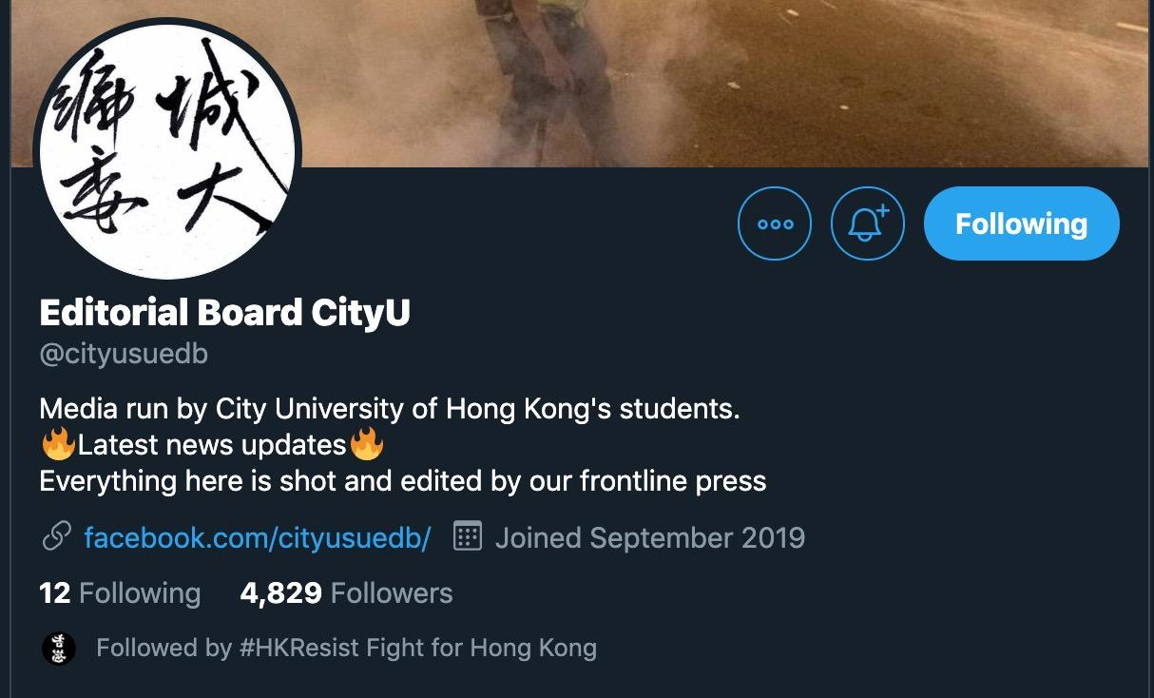
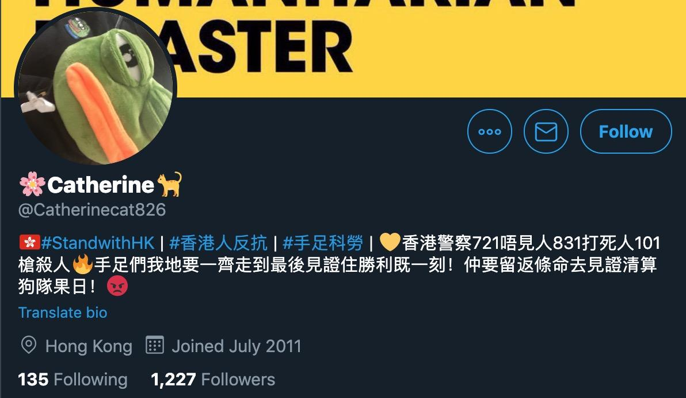
Twitter Influencers

Slide 21
03
Reddit Analysis

Slide 22
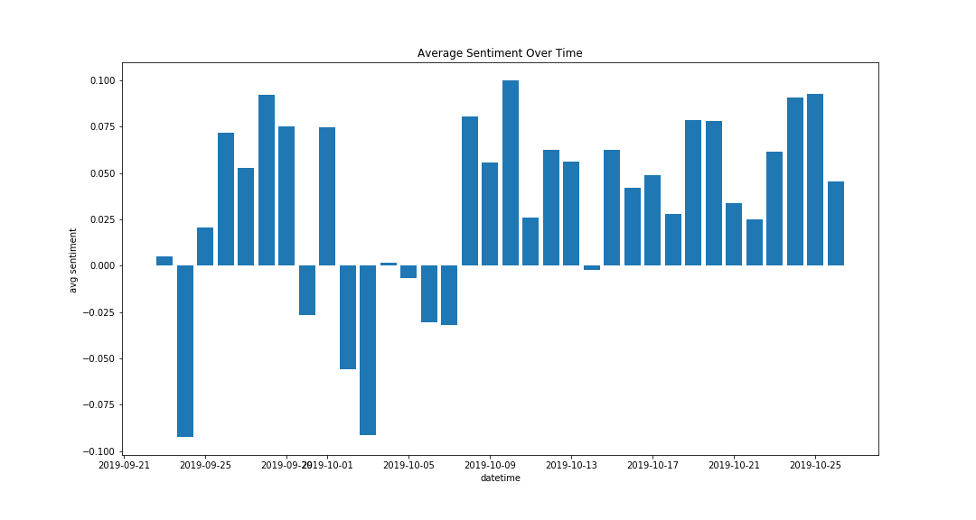
Sentiment Analysis
National Day Protest

Slide 23
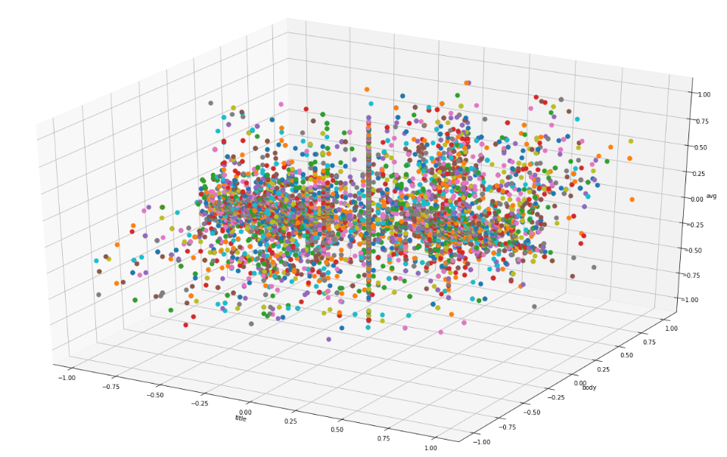
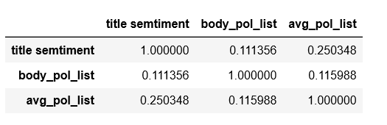
Correlation

Slide 24
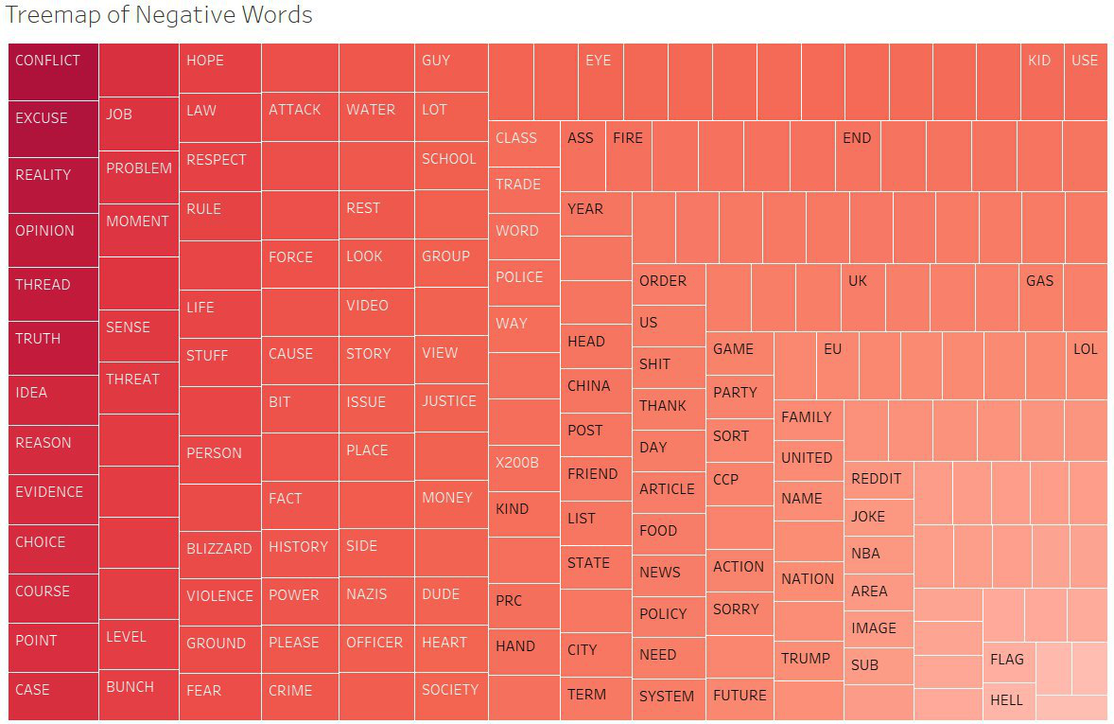
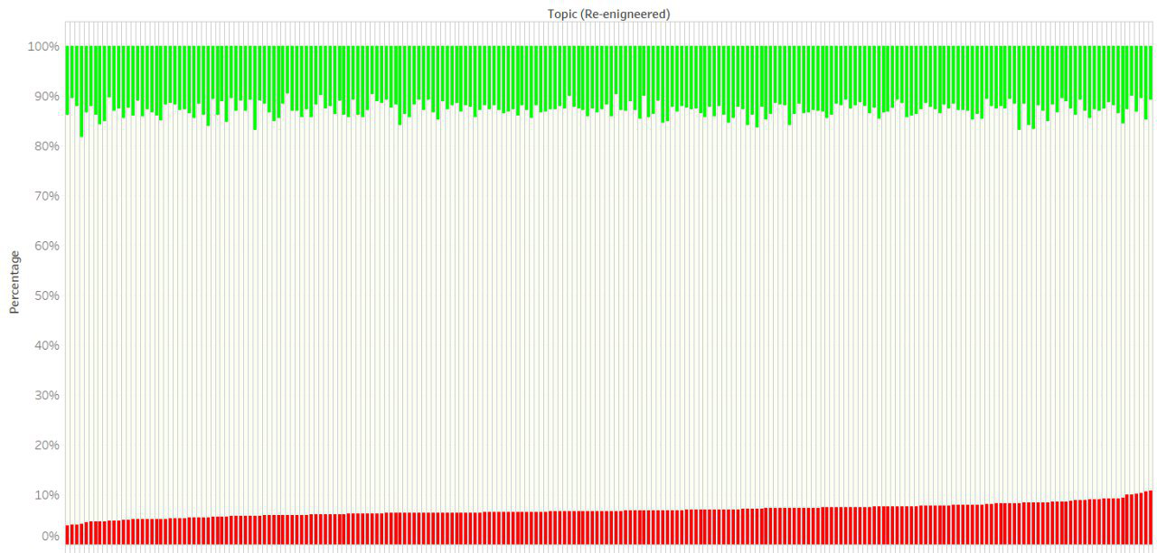
Topic Sentiment

Slide 25
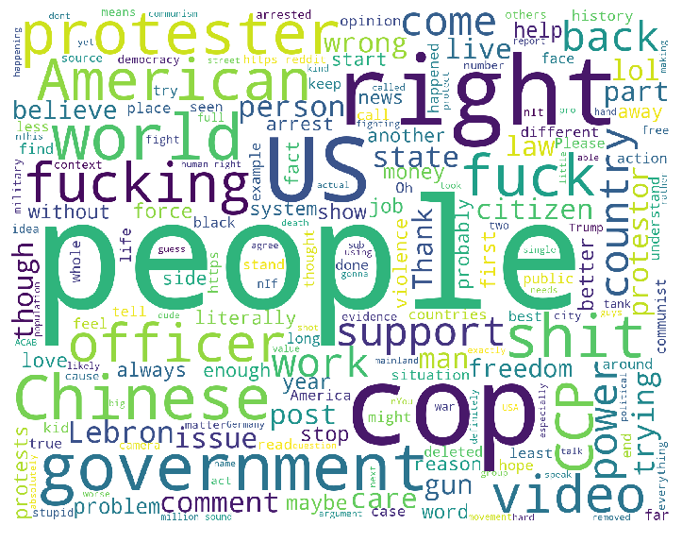
Word Cloud

Slide 26
04
Conclusion & Future Direction

Slide 27
Conclusion & Future Direction
Scalability
Wide Application
With larger amount of data and greater computational power
Systematic approach to discover insights in any social science related fields

Slide 28
THANK YOU
Team The Supreme Press
BU Wende
JIANG Hanyu
QI Haodi
ZHANG Chengzi

